Slide 1

Employee Performance Analysis Using
Excel
PRESENTED BY: MYTHILI.K
REGISTER NO: asunm1475312214629
DEPARTMENT: COMMERCE
COLLEGE: SRI KANYAKA PARAMESWARI ARTS &
SCIENCE FOR WOMEN

Slide 2

PROJECT TITLE
Employee Performance Analysis Using Excel

Slide 3
AGENDA
1.Problem Statement
2. Project Overview
3.End Users
4.Our Solution and Proposition
5. Dataset Description
6. Modelling Approach
7. Results and Discussion
8.Conclusion

Slide 4
PROBLEM STATEMENT
The problem is to identify the Human Resources (HR) department
of XYZ Corporation aims to evaluate and improve employee
performance across various departments. Currently, performance
data is collected, but it is not systematically analysed to provide
actionable insights. The HR team needs a comprehensive analysis of
employee performance metrics to identify top performers,
underperformers, and trends over time.

Slide 5
PROJECT OVERVIEW
• Analyze employee performance metrics to identify strengths, areas for
improvement, and overall trends.
• Implement PivotTables to summarize and categorize performance data.
• Compare individual employee performance against benchmarks or targets.
• Analyze seasonal or project-specific performance
variations. .
• Design dashboards for easy visualization of performance
metrics.
• Share analysis results with management for decision_x0002_making.

Slide 6
WHO ARE THE END USERS?
1. Human Resources Team
2. Managers
3. Executives
4. Training and Development Teams
5. Compensation and Benefits Teams
6. Performance Review Committees

Slide 7
OUR SOLUTION AND ITS VALUE PROPOSITION
• Flexibility to adapt the analysis to different roles, departments, or performance criteria, ensuring relevance and accuracy in evaluations
• Solution Data-driven analysis that support performance reviews,promotions, compensation decisions, and targeted training.
• Solutions The ability to analyze both current and historical performance data, with periodic updates to keep information.
• Value Proposition Saves time and reduces the risk of human error,ensuring consistent and reliable reporting across the organization.
• Value Proposition Ensures the tool evolves with the organization'sneeds, staying relevant and effective in a dynamic work environment.
Click here to add the text, the text is the extraction of your thought, please explain the point of view succinctly.Your text is already full of words, but the information is complex and needs to be expressed in more words.If you express your views properly, you can often get twice the result with half the effort.

Slide 8
DATASET DESCRIPTION
EMPLOYEE ID: Unique identifier for each employee in the
organization.
FIRST NAME: The first name of the employee.
PAY ZONE: The pay zone or salary band to which the employee's
compensation falls.
DEPARTMENT TYPE: The broader category or type of department the
employee's work is associated with.
CURRENT EMPLOYEE RATING: The current rating or evaluation of
the employee's overall performance.

Slide 9
MODELLING
DATA SET: Kaggle, Employee dataset
FEATURE SELECTION: Slicer, Conditional Formatting,Designing
DATA CLEANING Missing values, Irrelevant data, Correct Errors, Remove Unnecessary Columns and Rows
PIVOT TABLE: Employee ID, First Name, Performance Score.
CHART: Report of Employee Performance based on their Current Ratings is resented as Column Chart.

Slide 10
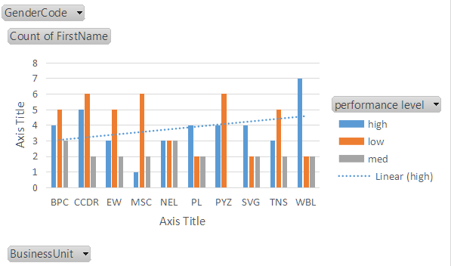
RESULTS

Slide 11
CONCLUSION
.
In conclusion, conducting an employee performance analysis using Excel
provides a structured and efficient way to evaluate and track performance
metrics. Excel's versatile functions and tools, such as pivot tables, charts,
and conditional formatting, allow for clear data visualization and analysis,
facilitating informed decision-making. By systematically analyzing
performance data, management can identify trends, strengths, and areas for
improvement, enabling targeted interventions and fostering a culture of
continuous improvement. Regular updates and reviews of this data ensure
that performance management remains dynamic and aligned with
organizational goals

Slide 12
REFERENCE
Dr.MEKALA THIRAVIDAMANI
Assistant Professor
Sri Kanyaka Parameswari Arts and Science For
Women , Chennai, Tamil Nadu
.

Slide 13
Thank you
T

